Slide 1

BIG DATA MANAGEMENT
Professors
Sergio Flesca Linda Oro
Course degree
Computer Engineering of IoT A.A. 2019/20
Candidates
Fabio Capparelli 214490 Luigi Rachiele 214894

Slide 2
Our STACK:
Data source | HDFS, Local File System, Socket tcp
Data processing and analisys | MapReduce, Spark, Spark Streaming
Data storing | HBase

Slide 3
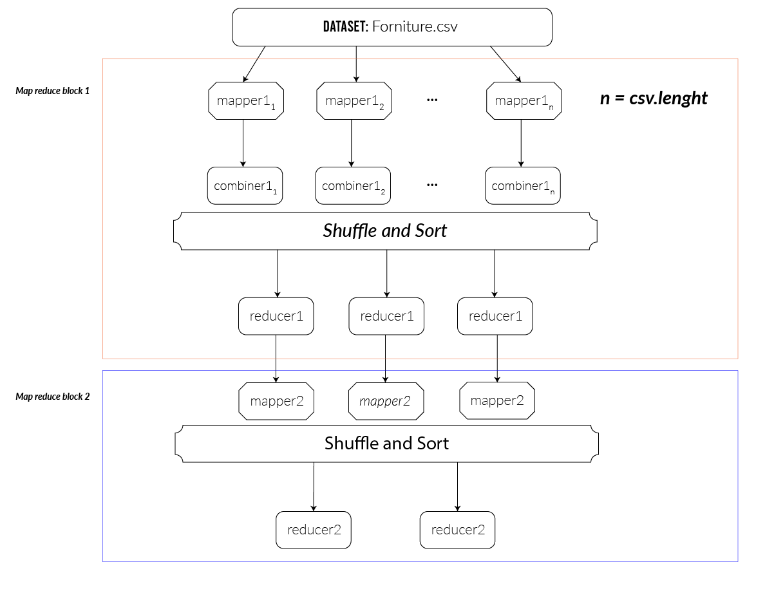
Query 1:
Data source: HDFS Framework/data processing: Map Reduce Dataset: forniture.csv
https://github.com/pcm-dpc/COVID-19/blob/master/dati-contratti-dpc-forniture/dpc-covid19-dati-contratti-dpc-forniture.csv.
Data storing: Hbase
Definiton: return the company/supplie that has provided the major number of product for each category (FFP2, FFP3) and the quantity to the Civil Defence.
Commands to run:
hdfs dfs -put forniture.csv hdfs:///in1
hadoop jar q1.jar Query1 hdfs:///in1 hdfs:///out11 hdfs:///out12
n = blocks of csv file in HDFS

Slide 4
Output from HBase

Slide 5
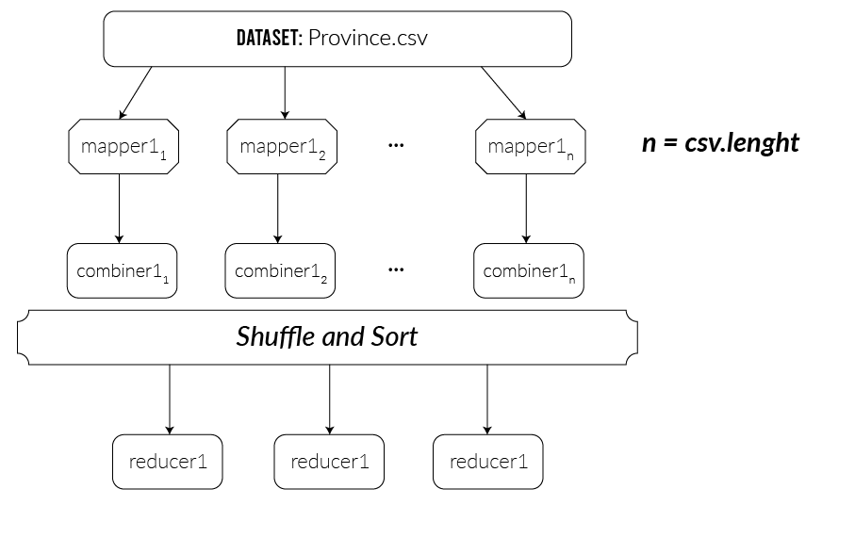
Query 2:
Data source: HDFS Framework/data processing: Map Reduce Dataset: province.csv
https://www.kaggle.com/sudalairajkumar/covid19-in-italy
Data storing: Hbase
Definiton: return the infections and the actual positive for each day (from 02-24 to 07-20) for the given province.
Commands to run:
hdfs dfs -put province.csv hdfs:///in2
hadoop jar q2.jar Query2 hdfs:///in2 hdfs:///out2 CS
n = blocks of csv file in HDFS

Slide 6
Output from HBase

Slide 7
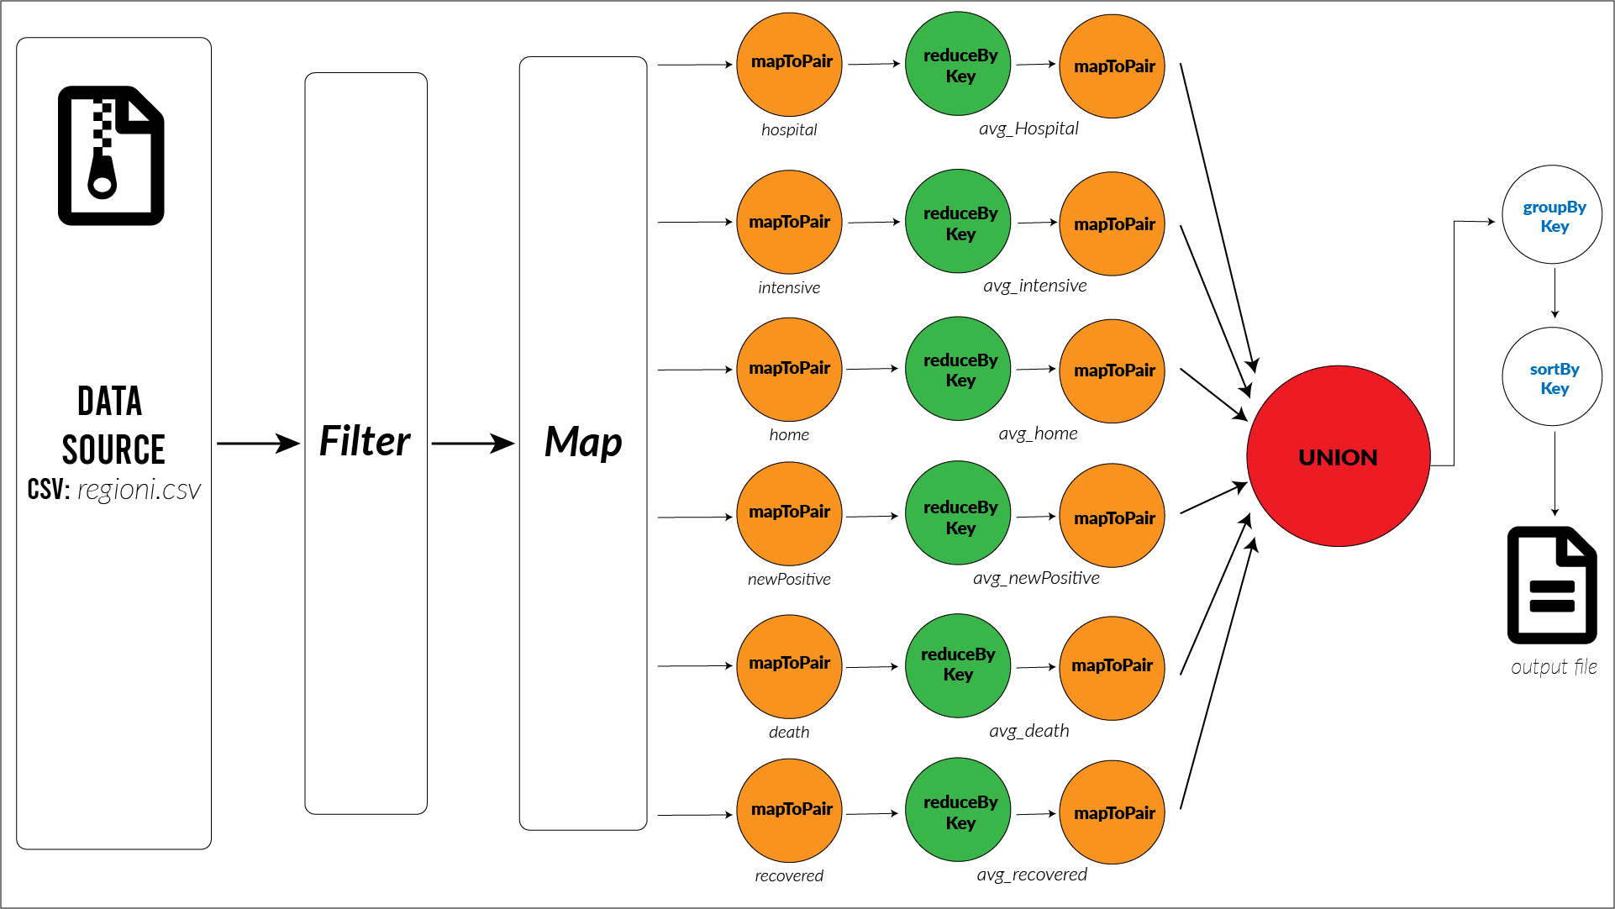
Query 3:
Data source: Local File System Framework/data processing: Apache Spark Dataset: regioni.csv
https://www.kaggle.com/sudalairajkumar/covid19-in-italy
Data storing: Hbase
Definiton: return the average of infected that are (Hospitalized, Intensive, Home confinement, positive, death, recovered) for each region from 02-24 to 07-20.
Commands to run:
docker build –rm=true –t query/3
docker run --name Query3 -e ENABLE_INIT_DAEMON=false --link spark-master:spark-master -d query/3

Slide 8
Output from HBase

Slide 9
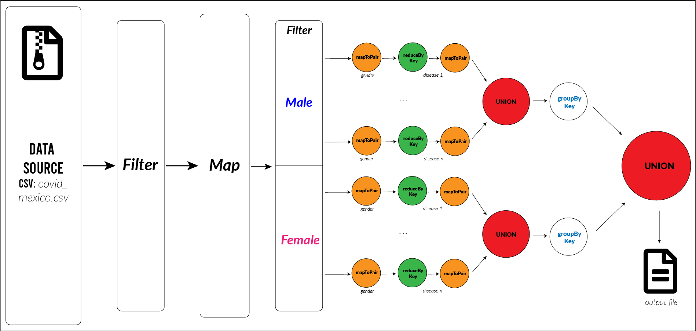
Query 4:
Data source: Local File System Framework/data processing: Apache Spark Dataset: covid_mexico.csv
https://www.kaggle.com/tanmoyx/covid19-patient-precondition-dataset?select=covid.csv
Data storing: Hbase
Definiton: return the average in percentage of patologies and characteristics of deaths in this data set (diabet, tobacco, pregnant for female and so on).
Commands to run:
docker build –rm=true –t query/4
docker run --name Query4 -e ENABLE_INIT_DAEMON=false --link spark-master:spark-master -d query/4

Slide 10
Output from HBase

Slide 11
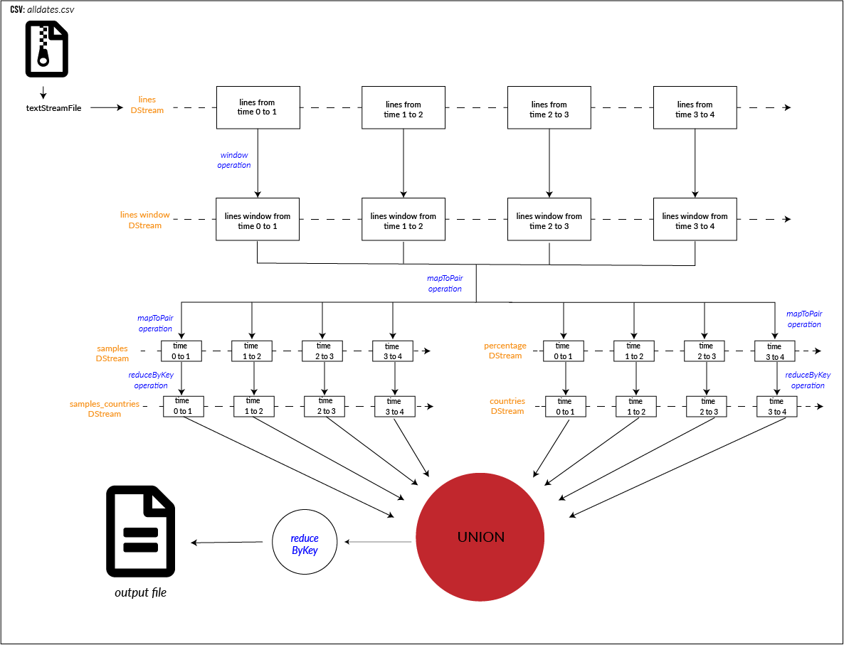
Query 5:
Data source: Socket tcp Framework/data processing: Apache Spark Streaming Dataset: alldates.csv
https://www.kaggle.com/skylord/covid19-tests-conducted-by-country
Definiton: return the average in percentage of the relation (tested perfomed/tested done) for each coutries in the world counted month to month.
Commands to run:
docker build –rm=true –t query/5
docker run --name Query5 -e ENABLE_INIT_DAEMON=false --link spark-master:spark-master -d query/5

Slide 12
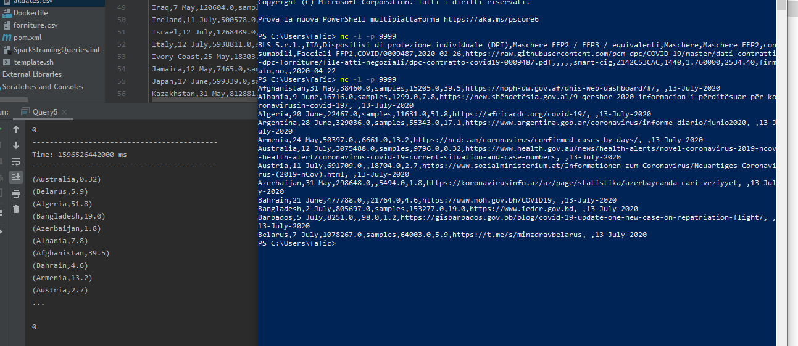

Slide 13
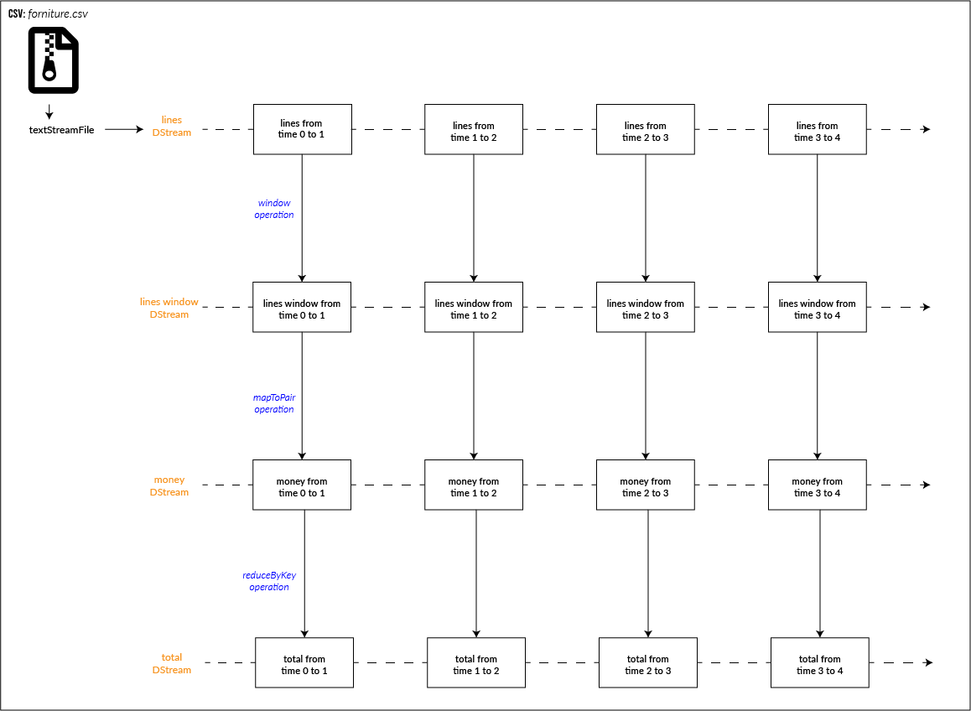
Query 6:
Data source: Socket tcp Framework/data processing: Apache Spark Streaming Dataset: forniture.csv
https://github.com/pcm-dpc/COVID-19/blob/master/dati-contratti-dpc-forniture/dpc-covid19-dati-contratti-dpc-forniture.csv.
Definiton: the total money spent by the Civil Defence for each produtc category (FFP2, FFP3, fan ..)
Commands to run:
docker build –rm=true –t query/6
docker run --name Query6 -e ENABLE_INIT_DAEMON=false --link spark-master:spark-master -d query/6

Slide 14
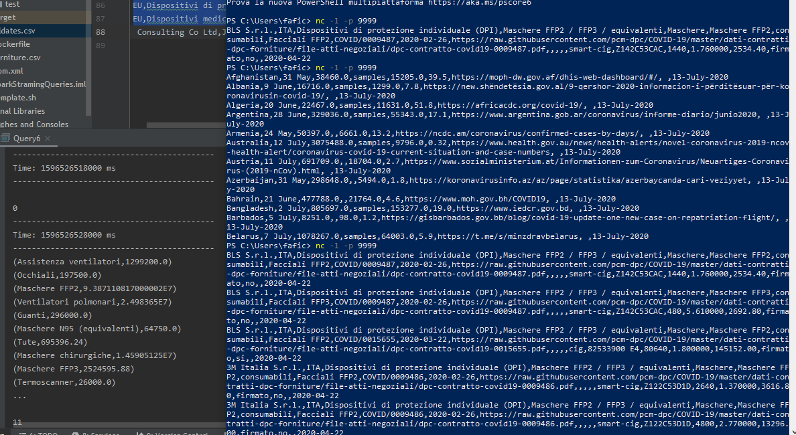

Slide 15
THANKS FOR THE ATTENTION

